Slide 1
Traffic and Weather Conditions in D.C.
Traffic and inclement weather tend not to mix. My goal is to observe interactions between the two, by looking at which factors in the weather have the most significant impacts on the number of crashes.

Slide 2
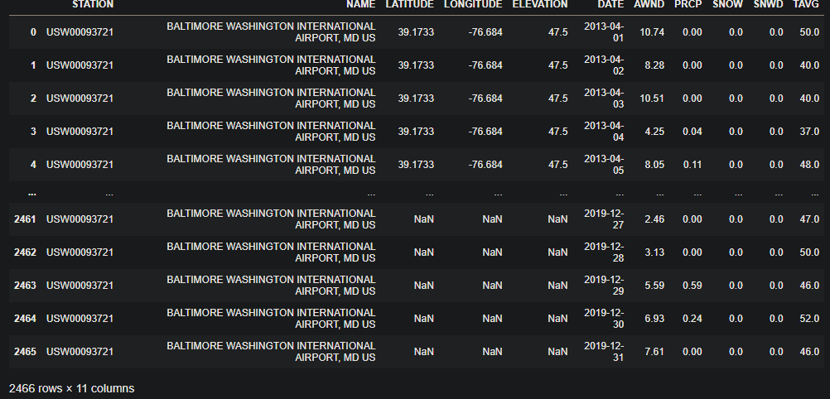
Weather Data
2466 entries (2013-04 to 2019)
Some of the data isn’t particularly useful (but may be nice to have)
AWND - Average wind speed
PRCP - Precipitation
SNWD - Snow Depth
SNOW - Snowfall
TAVG - Average temperature
I originally gathered data from 2012-2019, but the 2012 data and some of the 2013 data was missing the predictors I was looking for, so I cut it out, along with repeat dates (since there are multiple observation areas, I just took the first unique one per day).

Slide 3
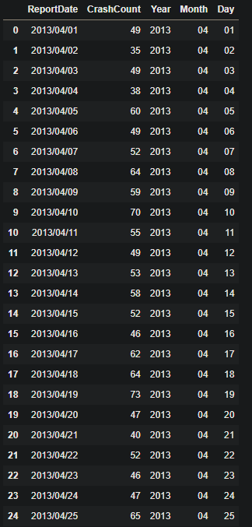
Crash Data
Fully cleaned data
Removed data prior to 2013/04/01 and after 2019/12/31
Derives year/month/day from ReportDate
Derives CrashCount through a groupby on ReportDate
Removes 59 columns

Slide 4
Solution
Determine which of the factors most influence crashes by creating a model to predict crashes
Plot scores of each feature side by side

